Slide 1
The meaning of emojis
SEMSVEND – a workshop in honor of
Svend Østergaard (1949-2017)
Ole Togeby
Professor emeritus
norot@cc.au.dk
Notes:
Friday May 4th 2018 Room 1481-239
Emojis defined
Modal ensemble
Meaning of double articulated signs
Meaning of emojis
Interpretation of emojis.

Slide 2
Plan
Emojis defined
Modal ensemble
Meaning of double articulated signs
Meaning of single articulated emojis
Interpretation of emojis.

Slide 3
Emoji
I.
An emoji is an pictogram that takes part in a modal ensemble in electronic messages and web pages, and which belongs to an inventory (e.g.: ☺ ☎ ⌚ ✄ ✈).
  Originally meaning pictograph, the word emoji comes from Japanese e ("picture") + moji ("character"). The resemblance to the English words emotion and emoticon is purely coincidental.
Notes:
Facebookkommentar modstridende vilkår:
dels som skrift: grafisk, permanent, planlagt, en-til-mange, pseudonym,
dels som samtale: kort, forbrug, dialog, næsten simultan.
Manglen på naturlige symptomale tegn (gestik, mimik, stemmeføring) kompenseres ved multimodalitet:
foruden konventionelle bogstaver bruges: billeder, emojier, smileys, emotikoner, likes.

Slide 4
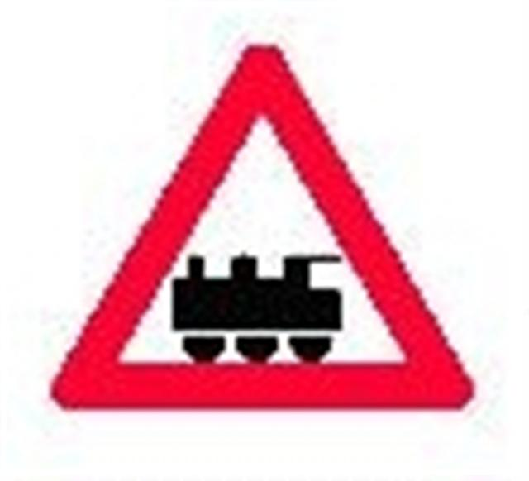
Pictogram
I.
A pictogram is ideogram that conveys its meaning through visual analogy of a stylized graphic type with an object, through social convention and through local anchoring at the same time (e.g.: traffic signs, emojis, and icons).

Slide 5
Ideogram
I.
An ideogram is the utterance of a communicative sign that is single articulated and with a meaning defined in opposition to the meanings of other ideograms of an inventory of ideograms. Ideograms are single articulated signs with (pictograms) or without visual analogy, e.g. : § £ $ € †.

Slide 6
Communicative sign
(Grice: non-natural sign)
I.
A communicative sign is the utterance of a type of remarkable form that by others in a sign community is meant to be interpreted as information about something different from what they are (e.g.: speech, written texts, paintings, gestures, devices for measurement, a thermometer).

Slide 7
Linguistic sign
A linguistic sign is a the utterance of a double articulated sentence (or a composition of sentences) which has a truth value, and which is syntactically composed of words and morphemes.
A morpheme is a fixed row of concatenated minimal linguistic units (phonemes = linguistic sounds or graphemes = linguistic graphs) chosen from a linguistic inventory (a dictionary). Phonemes and graphemes are chosen from a linguistic alphabet.

Slide 8
Sign
A sign (natural or communicative) is a remarkable form that is interpreted as information about something different from what it is (e.g.: natural signs such as footprints, and non-natural signs such as linguistic utterances)

Slide 9
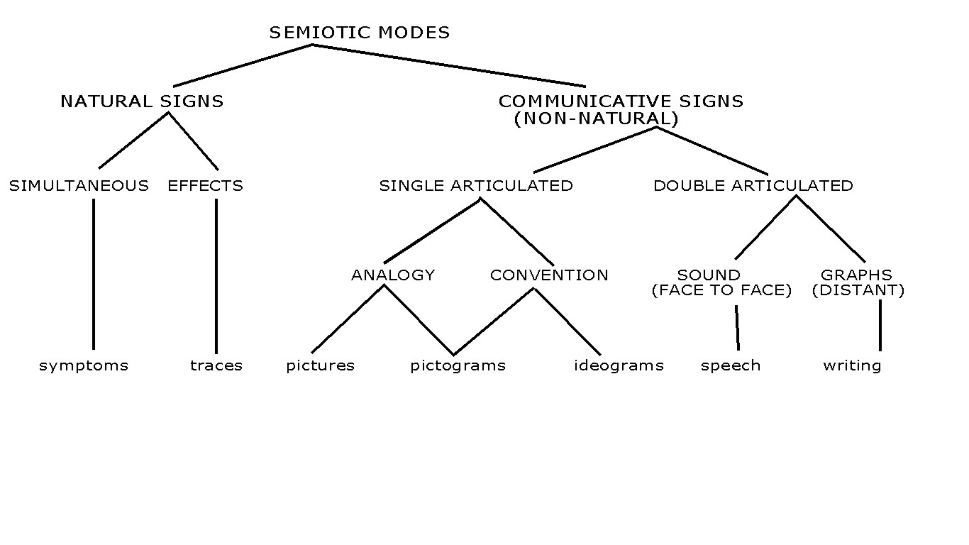
Semiotic modes

Slide 10
Ensemble
Modal ensemble is the layout and arrangement of semiotic resources for making a specific message, designed so that each mode has a specific task and function.
  Gunther Kress 2010: Multimodality. A social semiotic approach to contemporary communication, Oxon: Routledge
Notes:
II.
De forskellige medlemmer af ensemblet skal spille sammen til en samlet mening af et (distributionet defineret) samlet tegn.
Hvordan spiller tekst og emoji sammen til en samlet kommunikativ handling?

Slide 11
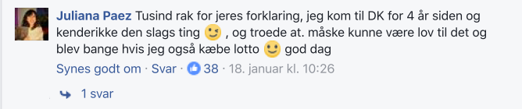
The syntax of multimodal ensembles
Emojis are always part of a multimodal ensemble together with conventional ideograms and linguistic sentences or words and have various functions depending on the semiotic unit in which they occur (a whole electronic message, a written text, a sentence).
Notes:
Emojier er som oftest placeret som et element i et multimodalt ensemble sammen med tegnelementer af andre typer (sproglige bogstaver og billeder) i en distributionel enhed.
Problemet er hvordan de spiller sammen.

Slide 12
The function of emojis
I. as a whole (electronic) reply
  A. as minimal response, e.g. likes (thumbs up)
  B. as genuine answer, standard emojis
II. as a comment to a linguistic sentence in a modal ensemble
  A. as a kind of punctuation mark
  B. as a kind of attitude adverbial
  C. as a kind of illocutionary force indicator
III. as a part of speech or a word in a sentence, often as a NP (but not as in a rebus)
  A. as a word in a liguistic sentence
  B. as a syntactic unit composed solely by emojis
Notes:
II. Et tegn for et begreb (piktogram eller ideogram, svarende til et morfem) som er konstituent i et sætningsudsagn:
B. Attitudeadverbial, som parentetisk angiver propositionens valeur
1. informativitet: jo, sgu,
2. komposition: altså, endvidere, kort sagt,
3. kriteriemarkører: åbenbar, faktisk, givetvis, muligvis
4. vurderingsmarkører: desværre, forbavsende nok, utroligt nok

Slide 13
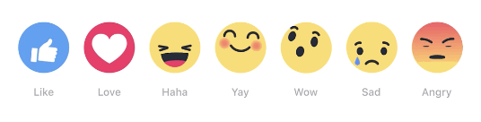
Facebook standard emojis
  Facebooks standard emojis:
Official translation:
a) Like — Thumbs Up; b) Love — Beating Heart; c) Haha— Laughing Face; d) Yay — Smiling Face (discontinued); e) Wow — Surprised Face; f) Sad — Crying Face, showing an animated tear; g) Angry — Red/ Angry/ Pouting Face:

Slide 14
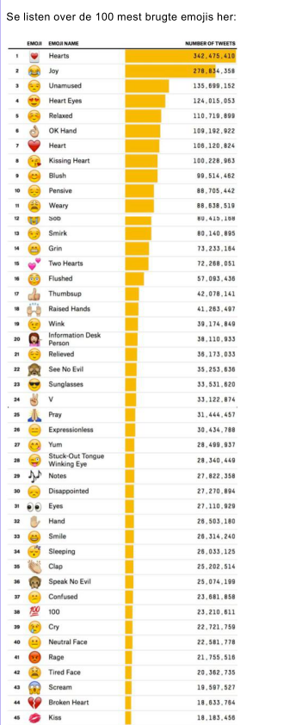
The most frequent emojis

Slide 15
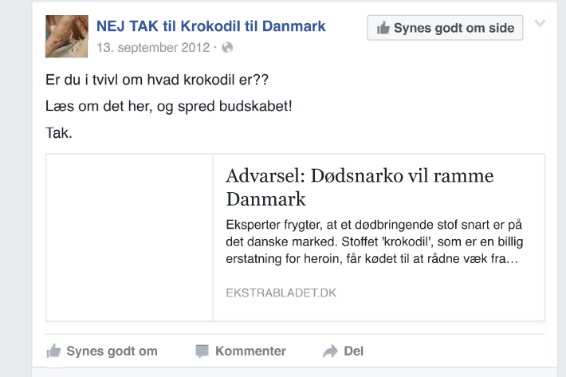
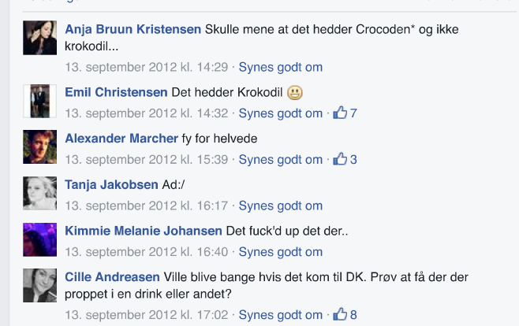
IA. Minimal response
I. as a whole electronic reply
  A. as minimal response, e.g. likes
  B. as genuine answer, standard emojis
II. as a comment to a linguistic sentence in a modal ensemble
  A. as a kind of punctuation
  B. as a kind of attitude adverbial
III. as a part of speech or a word in a sentence, often as a NP (but not as in a rebus)

Slide 16
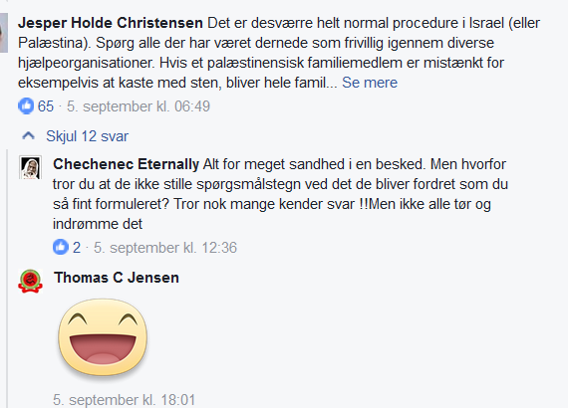
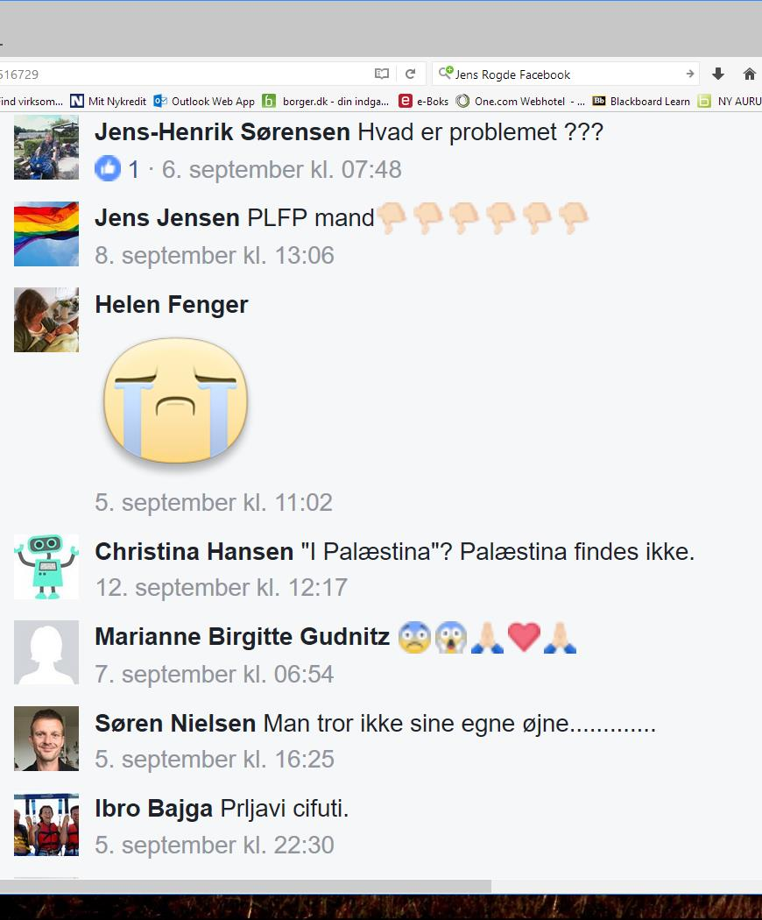
IB. Emojis as a genuine answer
Notes:
1. emotive
a. affekt: panik, raseri, begejstring:
b. emotion: vrede, frygt, glæde, bedrøvelse, interesse, overraskelse, afsky, foragt, forlegenhed, skam
c. sekundære emotioner: stolthed, jalousi, skadefryd, lykke, kærlighed, overmod, angst, selvagtelse
d. vitalitetsfølelse: brusende, sprød, sprudlende, lys, svævende, irritabel, vemodig, dunkel, let, munter, tungsindig, heftig, sindig, gnaven, dyster, tøvende
e. stemning: glad, mørk
f. temperament
Boje Katzenelsom 2004: Drivkræfter, følelser og erkendelse

Slide 17
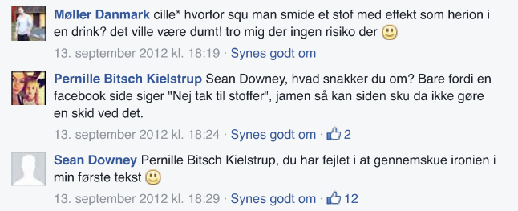
IIA. Smiley as an punctuation mark
In many contributions a smiley replaces a full stop and has the same function, meaning: ‘My message is finished by this’.

Slide 18
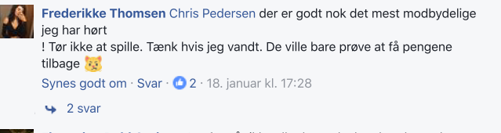

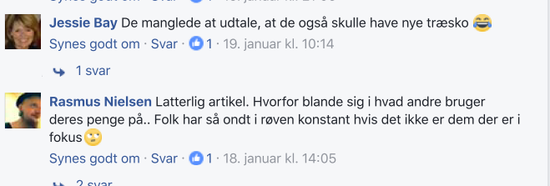
IIA.Emojis as punctuation

Slide 19
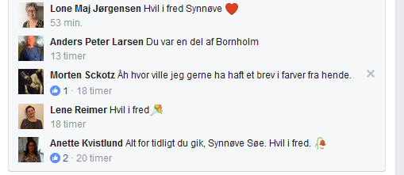
IIB. Emoji as an attitude adverbial

Slide 20
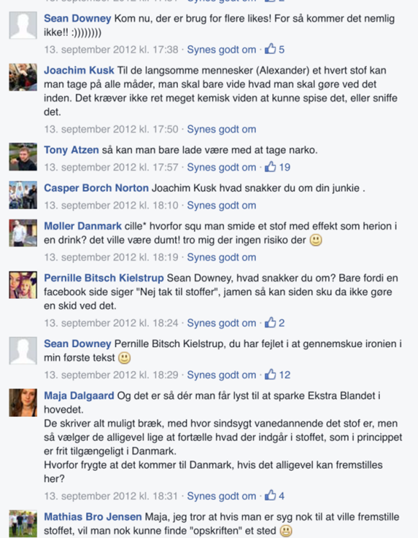
IIC.Krokodil
IFI
Comment 13-9-12:
  NEJ TAK til krokodil i Danmark
    NO THANKS to krokodil in Denmark
  Er du i tvivl om hvad krokodil er??
    Do you have doubts about what krokodil is??
  Læs om det her, og spred budskabet!
    Read more about it here, and diffuse the message
  Tak.
    The drug krokodil is a cheap substitute for heroin and is produced when users mix kodein and petrol.
Notes:
Stoffet krokodil, fungerer - ifølge Ekstra Bladet - “som en billig erstatning for heroin, og produceres når brugerne blander kodein med benzin, olie eller alkohol. Herefter filtreres og koges det, inden det bliver sprøjtet ind i venerne. - Selvom de mener, at det meste af olien og benzinen er væk, er der stadig rester af det. Du kan forestille dig bare at indsprøjte en lille smule af det i dine årer kan forårsage en masse skader.”
The contribution is ndlægget er delt 18 gange, liket 54 gange og kommenteret 67 gange (Schimmelmann 2016). Efter flere kommentarer fra kl. 14:29, som fx fy for helvede, Ad:/ (en ad-smiley) og Det er fuck’d up det der..,
I

Slide 21

IIC. Illocutio-nary force indicator

Slide 22
IIC.Krokodil
13. Sep 2012 kl. 17:38
Sean Downey Kom nu, der er brug for flere likes! For så kommer det nemlig ikke!! :))))))))
  Come on, more likes are needed. Because then it will not come!! :)))))))
  ‘:)’ = ☺
Notes:
Og når man finder en tegngiver der siger noget, som ved (a) et brud på Grice’s maksimer er markeret som (b) et modificeret ekko af adressatens tanke, hvorved der (c) uden ansvar for afsenderen er underforstået (d) en hån af adressaten, er der tale om et eksempel på sarkasme; sarkasme i modsætning til ironi, som ikke er en hån af adressaten, men en kritik af sagen som adressatens tanke er om (Togeby 2013).
Denne kommentar må tolkes således: Den er komponeret som en opfordring + en begrundelse + en smiley. Opfordringen til de andre kommentatorer i tråden er et brud på Grice’s maksime om informativitet, for der har allerede været mange likes. Og begrundelsen skal vel forstås således at hvis der kommer mange likes, kommer stoffet krokodil ikke til Danmark. Det turde være et brud på maksimet om sandhed.
Og når man finder en tegngiver der siger noget, som ved (a) et brud på Grice’s maksimer er markeret som (b) et modificeret ekko af adressatens tanke, hvorved der (c) uden ansvar for afsenderen er underforstået (d) en hån af adressaten, er der tale om et eksempel på sarkasme; sarkasme i modsætning til ironi, som ikke er en hån af adressaten, men en kritik af sagen som adressatens tanke er om (Togeby 2013).
Det er nok denne sarkasme Sean Downey har villet markere med den metakommunikative smiley med de 8 smilemunde. Sean Downey mener - antagelig - at det er tåbeligt at give likes til sådan en sag på Facebook, og at det kun er idioter der gider at kommentere på den slags. Der er også tegn på at Facebookgruppen fra begyndelsen af er oprettet af en troll der vil få folk til at dumme sig ved at like en sådan sag (Schimmelmann 2016). Om Sean Downey er med i oprettelsen af gruppen, ved man ikke.

Slide 23
”:)))))” indicates ‘irony’
  Come on, more likes are needed. Because then it will not come!! :))))))).
  This comment is probably irony or sarcasm, because
a) it is a violation of Grice’s maxims (not thrue),
b) it is modified echo of a thought of the addressee,
c) and without responsibility for the speaker is implicated
d) scorn of the values of the addressee.

Slide 25
The ironical illocutionary force indicator ”:))))” is not understood
Kl. 18:24
Pernille Bitsch Kielstrup Sean Downey, hvad snakker du om? Bare fordi en facebook side siger “Nej tak til stoffer”, jamen så kan siden sku da ikke gøre en skid ved det.
  Sean Downey, what do you talk about. Only because a facebook page says ” No thank you to drugs”, but then the page can’t damned do the shit out of me about it.
kl. 18:29
Sean Downey Pernille Bitsch Kielstrup, du har fejlet i at gennemskue ironien i min første tekst :-).
  PBK, you have failed in realizing the irony of my first text

Slide 26
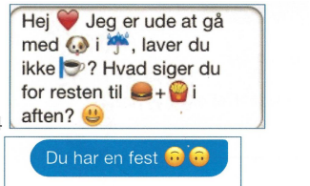
IIIA. Emojis replacing words in linguistic sentences
Hey <3 , I am walking with # in #, don’t you make #? By the way, what about # + # to night) ☺
Emojis replacing words occur in phone calls, but not often on public Facebook pages.

Slide 27
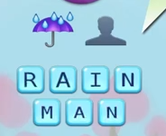
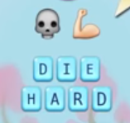
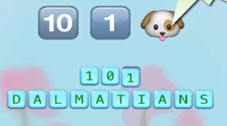
IIIB. Syntactic unit (film title) composed by emojis

Slide 28

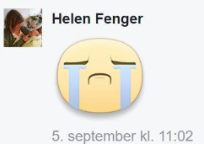



The function of emojis
I. as a whole electronic reply
  A. as minimal response, e.g. likes
  B. as genuine answer, standard emojis
II. as a comment to a linguistic
sentence in a modal ensemble
  A. as a kind of punctuation
  B. as a kind of attitude adverbial
  C. as a kind of illocutionary force indicator
III. as a part of speech or a word
in a sentence, often as a NP (but not as in a rebus)
  A. as a word in a liguistic sentence
  B. as a syntactic unit composed by emojis

Slide 29
Meaning of linguistic signs (sentence utterances)
A linguistic (written or spoken) sentence has double articulation with two levels: sentences and morphemes.
A functional linguistic unit is a sentence with semantic truth value.
A sentence is composed, according to morphological and syntactical rules, of minimal meaning units: words and morphemes.
Notes:
III.

Slide 30
Second articulation
Words and morphemes are selected from a infinit vocabulary of form-meaning pairings.
A language user has acces to at least 50.000 conventional words and morphemes.
Words and morphemes are sequences of linguistic units (letters or sounds) with no meaning, but only distinctive function.

Slide 31
The polysemi of morphemes
Most minimal meaning units (words and morphemes) are multiple ambigious:
right (noun):
  ret, rettighed
  højrehåndsstød
  retsiden af et stof
right (adj):
  rigtig
  ret (vinkel)
  rask
  I orden
  højre
right (adv):
rigtigt
lige (right now)
helt (right to the end)
højre (look right)
fint

Slide 32
Syntactic monosemiation
Normally the ambigious words are monosemiated by the syntax, because syntactic structures have meaning.
Thus the meaning of the sentence is normally not ambigious.
- I’ll give my left penis (and not the right one) to be normal.
- Are you sure it is the right one?
- And what about the one that will be left?
- Oh, it will be all right.

Slide 33
The meaning of emojis
Emojis have single articulation
i.e.: they are chosen from an inventory (emoji dictionary) with standard items (2363 for the time being).
In the inventory their meaning are defined by linguistic equivalents:
Notes:
IV.

Slide 34
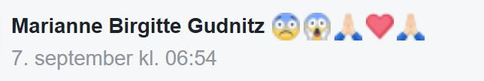
No syntax – no monosemiation
Emojis are not combinated according to syntax rules. If they are put in a sequence, their meaning can only be added unstructured into a pool of meaning

Slide 35
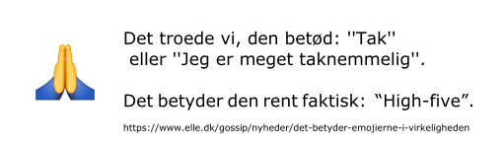
Dictionary definitions of emojis
What we thought it meant: ”Thank you” or ”I am very grateful”
What it in fact means: ”High-five”

Slide 36
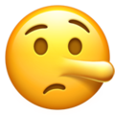

What is the meaning?
Two pictures of the same emoji (same unicode number) on different platforms.
Notes:
De siges begge at betyde ‘løgner’, men den venstre er ked af det og har måske fået en lang næse, mens den højre er smart og fortryder ikke, men tænker: ”Går den så går den”.

Slide 37
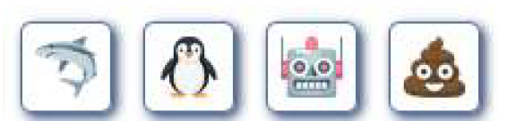
What is the meaning?
The dominant functions of emojis are IIB as a kind of attitude adverb and as a kind of illocutionary force indicator.
What is the attitude or illocutionary force conveyed of these emojis:

Slide 38
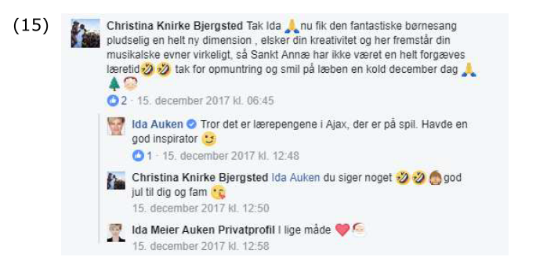
Interpretation of emojis
Notes:
V.
Anja Rennison: Emojier i dansk skriftsprog. BA-projekt 2016
Michelle Louise Friis von Schimmelmann 2016: SIOTrolling. BA-projekt
Boje Katzenelsom 2004: Drivkræfter, følelser og erkendelse
Katrine Marie Guldager 2017: Føleri får for meget plads i offentligheden. Politiken 23.
Grice, H.P. 1957: “Meaning” in Philosophical Review 66: 377-88
Grice, H.P., 1975: Logic and Conversation, i Cole, Peter & Jerry Morgan, 1975: Syntax and Semantics, vol. 3. Speech Acts, Academic Press, New York.
Habermas, Jürgen 1971: “Forberedende bemærkninger til en teori om den kommunikative kompetens”, oversat af Peter Widell og Niels Hornborg Jensen, i Henriksen, Carol (red) 2001: Can you reach the salt?, København: Roskilde Universitetsforlag
Kjeldsen, Jens E. 2006: ”Billedets retorik” i Klujeff & Roer 2006: Retorikkens aktualitet. Grundbog i retorisk analyse
Togeby, Ole 2003: Fungerer denne sætning? Funktionel dansk sproglære, København: Gad.
Togeby, Ole 2005: “Tegn og gerninger” i Cramer, Jens, Mette Kunøe og Ole Togeby (red) 2005: Teorien om alt og andre artikler om sprog og filosofi, Århus: Wessel og Huitfeldt, side 339-352.
Togeby, Ole 2005: “Ole tegner og fortæller. Om den semiotiske forskel på billeder og tekst” i Tidsskrift for Sprogforskning Årg. 3 nr. 1, Århus: Statsbiblioteket, side 29-46.
Togeby, Ole 2005: “Dette er (ikke) en pibe - billedtekster og tekstbilleder” i Widell, Peter og Mette Kunøe 2005: 10. møde om Udforskningen af Dansk Sprog. Aarhus Universitet 7.-8. oktober 2004, Århus: Aarhus Universitet, side 370-382.
Togeby Ole 2014: Bland blot genrerne – ikke tekstarterne! København: Samfundslitteratur
Watzlawick, Paul, Janet Helmick Beavin and Don D. Jackson 1968: Pragmatics of Human Communication. A Study of Interactional Patterns, Pathologies and Paradoxes, London: Faber and Faber.

Slide 39
Litteraturliste
Grice, H.P. 1957: “Meaning” in Philosophical Review 66: 377-88
Grice, H.P., 1975: Logic and Conversation, i Cole, Peter & Jerry Morgan, 1975: Syntax and Semantics, vol. 3. Speech Acts, Academic Press, New York.
Katrine Marie Guldager 2017: Føleri får for meget plads i offentligheden. Politiken 23.
Habermas, Jürgen 1971: “Forberedende bemærkninger til en teori om den kommunikative kompetens”, oversat af Peter Widell og Niels Hornborg Jensen, i Henriksen, Carol (red) 2001: Can you reach the salt?, København: Roskilde Universitetsforlag
Boje Katzenelsom 2004: Drivkræfter, følelser og erkendelse
Kjeldsen, Jens E. 2006: ”Billedets retorik” i Klujeff & Roer 2006: Retorikkens aktualitet. Grundbog i retorisk analyse
  Gunther Kress 2010: Multimodality. A social semiotic approach to contemporary communication, Oxon: Routledge
Togeby, Ole 2003: Fungerer denne sætning? Funktionel dansk sproglære, København: Gad.
Togeby, Ole 2005: “Tegn og gerninger” i Cramer, Jens, Mette Kunøe og Ole Togeby (red) 2005: Teorien om alt og andre artikler om sprog og filosofi, Århus: Wessel og Huitfeldt, side 339-352.
Togeby, Ole 2005: “Ole tegner og fortæller. Om den semiotiske forskel på billeder og tekst” i Tidsskrift for Sprogforskning Årg. 3 nr. 1, Århus: Statsbiblioteket, side 29-46.
Togeby, Ole 2005: “Dette er (ikke) en pibe - billedtekster og tekstbilleder” i Widell, Peter og Mette Kunøe 2005: 10. møde om Udforskningen af Dansk Sprog. Aarhus Universitet 7.-8. oktober 2004, Århus: Aarhus Universitet, side 370-382.
Togeby Ole 2014: Bland blot genrerne – ikke tekstarterne! København: Samfundslitteratur
Watzlawick, Paul, Janet Helmick Beavin and Don D. Jackson 1968: Pragmatics of Human Communication. A Study of Interactional Patterns, Pathologies and Paradoxes, London: Faber and Faber.

Slide 41
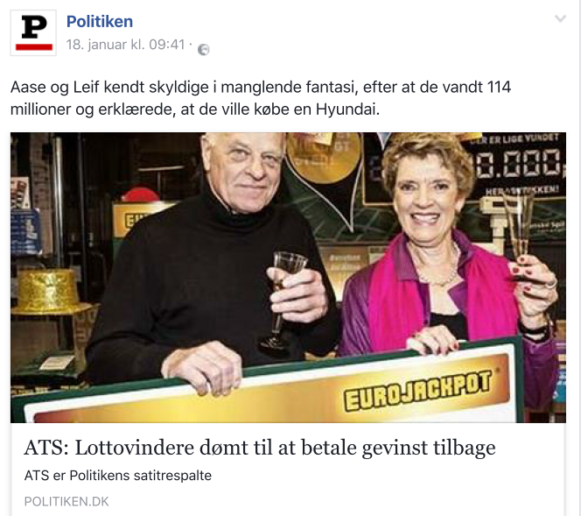
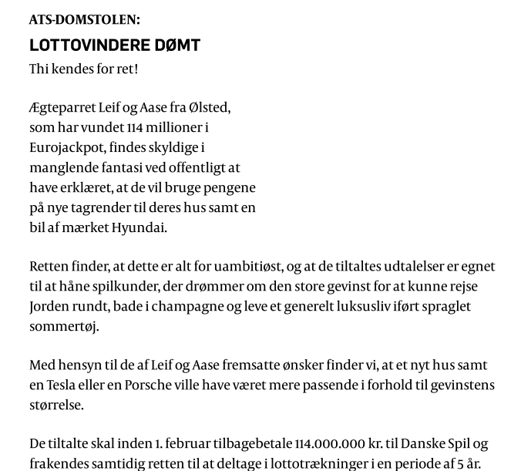
Lottovinderne

Slide 42
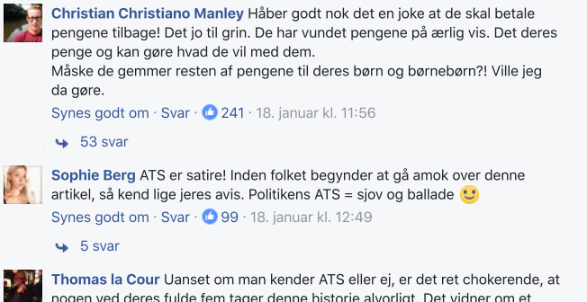
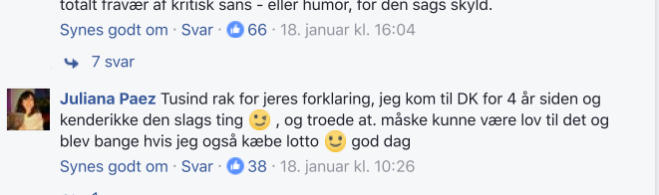
III.Lottovindere

Slide 43
